Slide 1


Slide 2

Logic Model
OUTPUTS
INPUTS
Activities: IAR
Participants
OUTCOMES
Market analysis
Companies and strategies around the world
Challenges
The challenges that ridesharing companies, users and government are and will have to solve)
Technology analysis
(the technological tools being used and that can be improved)
Transportation analysis
Law and Public policy
Social awareness
Efficient transportation
Traffic flow and reduction of CO2 emissions. Reduce transportation cost.
Market – Economic
Develop the market of carpooling and help new companies to take better decisions and strategies.
Social Impact
Understand the behavior and practice of people carpooling
Policies
Development of policies in order to regulate and increase the users of carpooling.
Improve security in carpooling
Resources:
Articles
Journals
Books
Lectures
Videos
Time:
One semester
Assistance:
Professors
The team members
Professors
Teacher assistant
Classmates
ASSUMPTIONS
External analysis report
Most part of statistics about carpooling are based in USA info.
EXTERNAL FACTORS
Government laws
Public transportation
Price of energy
Security

Slide 3
Motivations
In 2010 we passed 1`000.000.000 vehicles in the world.
In 2014 we produced 87`000.000 vehicles around the world.
More tan 90% of the time, our vehicle is parked. It highlights a crucial inefficiency of mass private car ownership.
Sources:
OICA 2014 Statistics
Journal Wards Auto
International Parking Institute

Slide 4
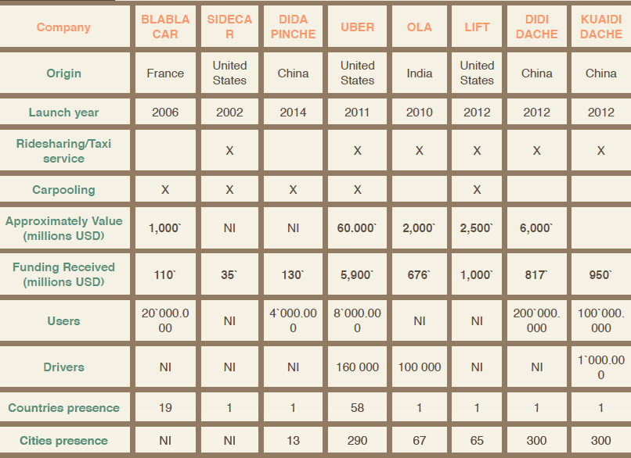
Market
Everyone is working with each other and
working against each other.
Sources: crunchbase.com

Slide 5

Transportation analysis
62% of the cars
38% of the cars
6,2 L/100km
7,5 L/100km
15477 km/Year
8225 km/Year
Annual cost 1002€
1,39€/L
Increasing occupation rate to 2 person per car, will save:
1,60€/L
400€
&
-12% of CO2 from transportation

Slide 6
Conclusion
Social benefits will make ridesharing and carpooling companies will work together with government policies.
Intelligent algorithms for real time ridesharing will make more efficient. Reducing cost and environmental impact.
The future is the share economy

Slide 7
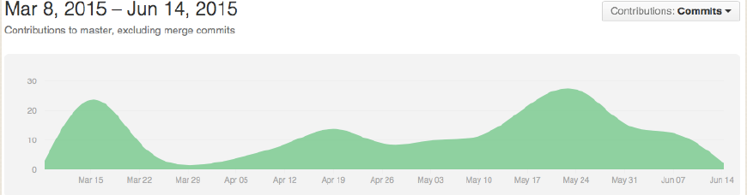
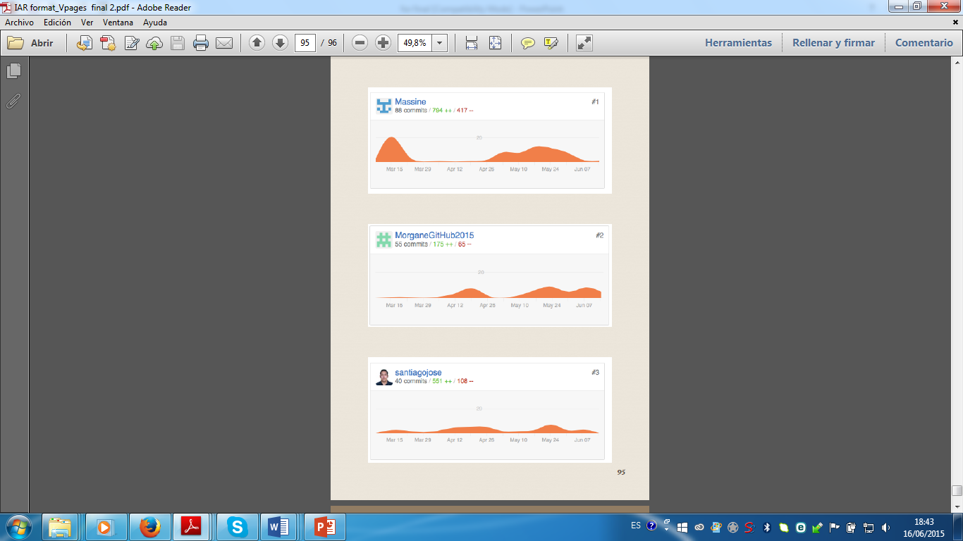
GitHub progress

Slide 8

Thanks for your attention !

